Slide 1

Vacation Rental Online Marketplace
Price Prediction Seattle City
Adi Lukmanto

Slide 2

Overview
Data description
Exploratory data analysis
Model
Conclusion

Slide 3
Data Description
Listings Dataset
Calendar Dataset
3818 listings / property
92 columns, with attributes describing different characteristics of the rented listings
Exactly one year information: 2016-2017 (365 days)
Has day to day values listed and daily stats of listings.
Has 4 columns, with 1393570 rows

Slide 4
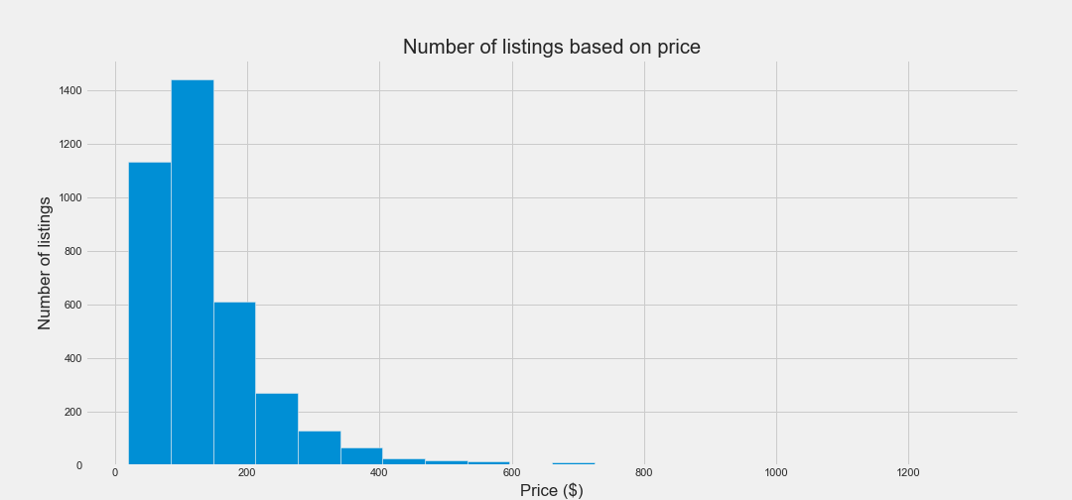
Accumulated Listing Prices
Minimum price is $10
Maximum price is $1650
Average price is $137.94

Slide 5
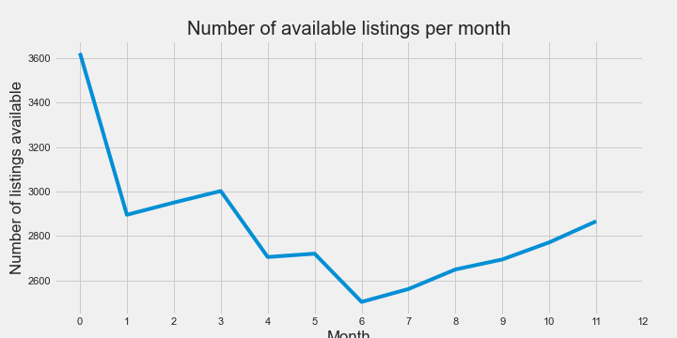
Available Listings per month
Number of available listings for reservation is tends to be the lowest in summer (June to August).

Slide 6
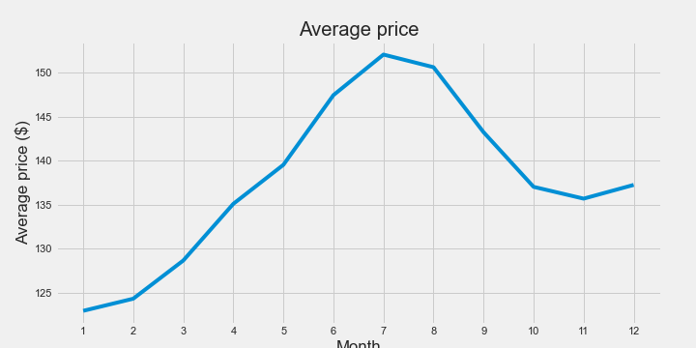
Average Price per month
Listing prices increased significantly in summer, due to less listings available.
There is also some increase in December.

Slide 7
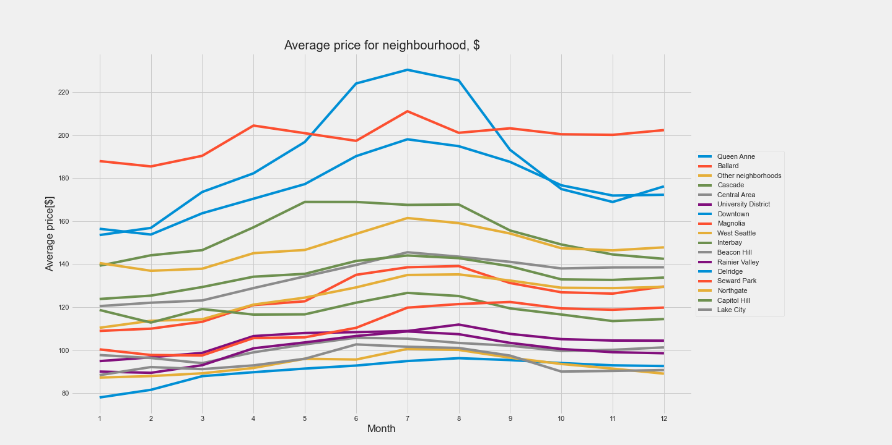
Prices based on Neighbourhood
The highest average prices are in Downtown.
Each neighbourhood prices tend to increase in summer.

Slide 8
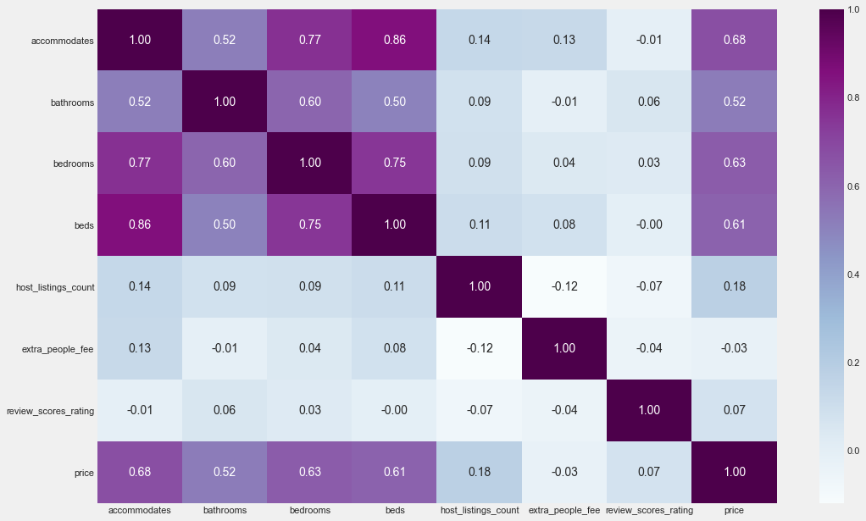
Correlation Table
Price is correlated with number of accomodates, bathrooms, bedrooms and beds.

Slide 9
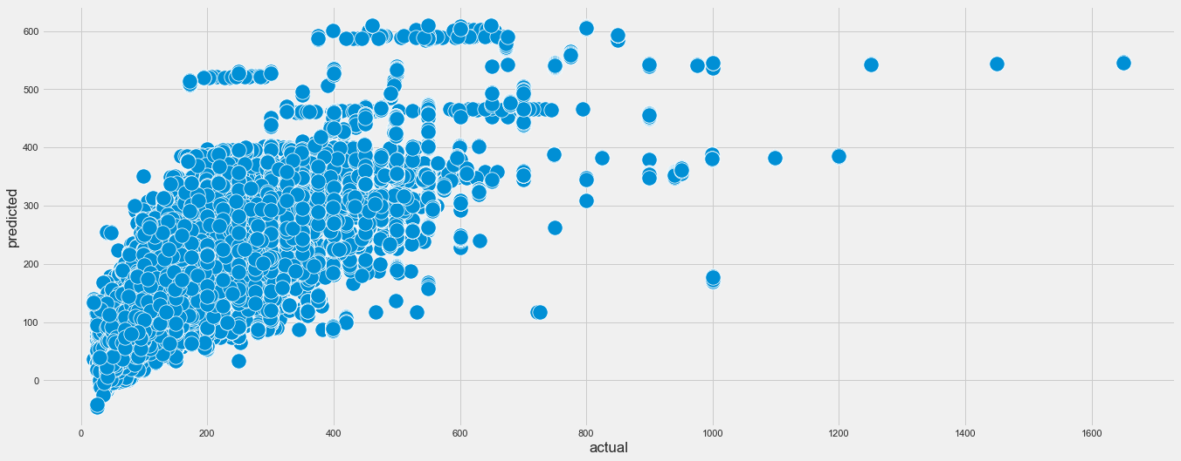
Model
Mean absolute error: 39.14
RMSE: 63.64

Slide 10
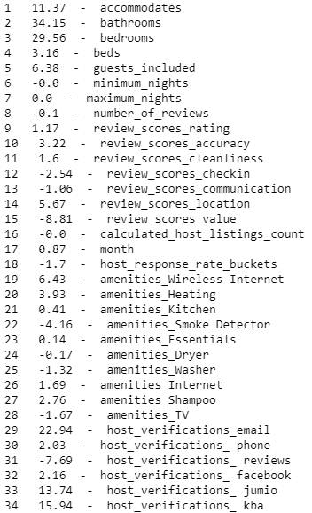
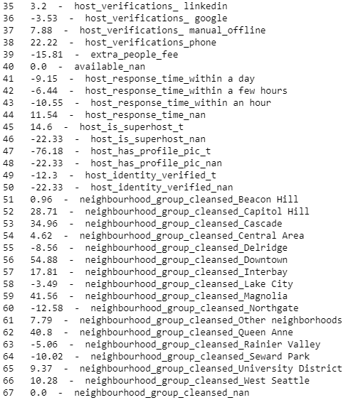
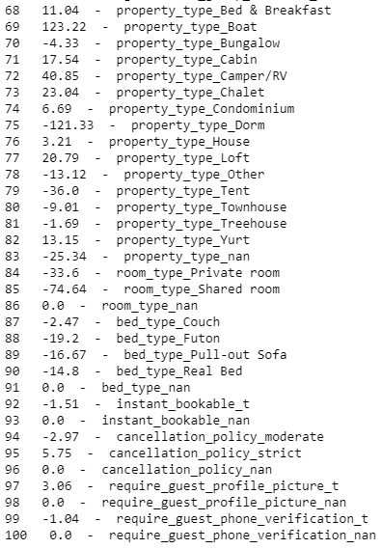
Model Coefficient

Slide 11
Conclusion / Suggestion
Providing more bathrooms, bedrooms, and beds will lead to higher listing price
Hosts can increase their listing price in summer, this is due to the fact that there are less listings available for reservation. But they will need to reduce their listing prices starting August.
Hosts may increase their listing prices again in December.
Summer and winter holidays are the busiest times to visit the city of Seattle.

Slide 12
Thank You.
Adi Lukmanto
081385565057
adilukmanto@gmail.com

